Slide 1

Hail Caesar
A robust Roman Numeral calculator

Slide 2
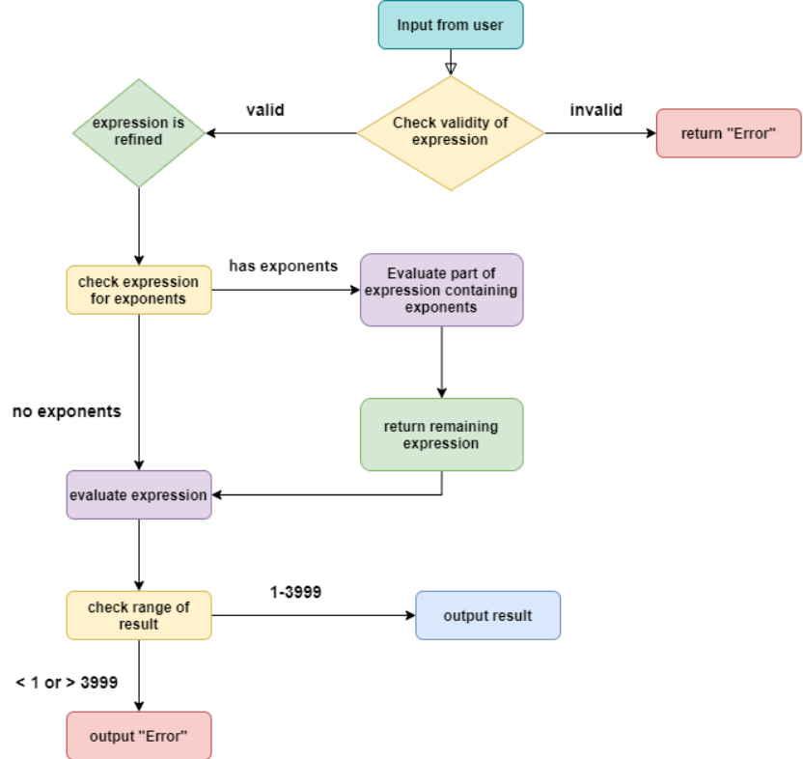
Backend
General overview of the program's backend

Slide 3
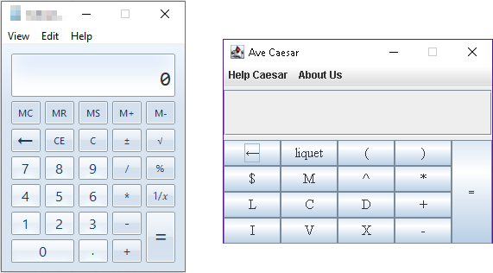
The Layout

Slide 4
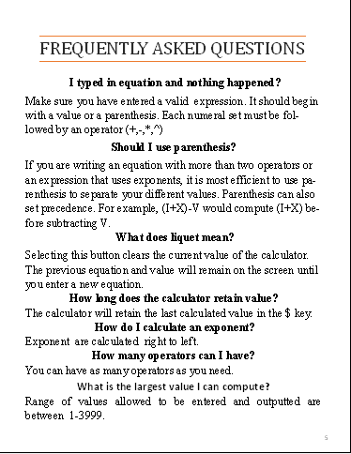
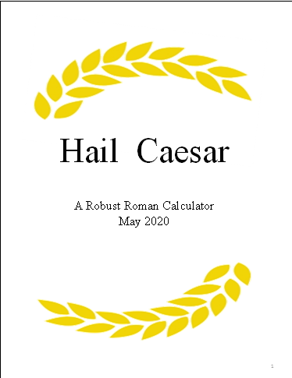
User Support
User Guide
Quick Reference Guide
Internal Guide
Notes:
User Interface Team
In the development of support materials to accompany the Roman Calculator. The team felt it pivotal to ensure a seamless onboarding of new users. As a result the calculator is accompanied by an easy to read User Guide. (pause)The guide includes step by step instructions on how to use the calculator, an explanation on Roman math, a list of frequently asked questions and a removable laminated Quick Reference Guide.
To ensure that your users are never too far from supportive materials the calculator is equipped with an internal guide locate in the Help Caesar Menu.

Slide 5
Buttons
When a button is pressed we check to see if it’s valid
If valid the button is displayed onto the calculator
Certain buttons have different functions
ex.
$ returns the last output
← deletes the last character input
Clear(Liquet) deletes whatever is on the display

Slide 6

Refining the Expression
Input: Roman numeral expression
Processing:
Replace any dollar sign ($) with the output of the previous expression
Convert all Roman numerals (I, II, III, IV, V, …) into Arabic numerals (1, 2, 3, 4, 5, …)
Output: Arabic numeral expression
Notes:
Hello I am Alex Micharski and I will be showing you the string parsing function. Now the string parsing function is quite simple. It takes in a roman numeral expression as a string. then it returns a string which replaces any dollar sign in the expression with the output of the previous expression, and converts every roman numeral into an arabic numeral.

Slide 7
Conversions, Ordering
Converting from decimals to roman numerals
450 = CDL
500(D) – 100(C) + 50(L)
Only certain characters may be subtracted from others (LD is invalid)
Converting from roman numerals to decimal
CDL
Find the most significant numeral (D), subtract the left (C) add the right (L)
Importance of ordering
450 = 100+100+100+100+50 = CCCCL (INVALID)
More than three of the same character in a row
Is represented officially as CDL

Slide 8

Roman Numeral Rules
The Symbols I, X, C and M can be repeated up to 3 times in succession
Basic symbols: I, V, X, L, C, D, M
If I, X or C appears before the symbol in line on basic symbols list, it is seen as subtraction
Ex: The number 2,944 in Roman Numerals is MMCMXLIV. It can be broken down as such: M + M + (M - C) + (L - X) + (V - I)
⟶ 1000 + 1000 + (1000 - 100) + (50 - 10) + (5 - 1)
When a symbol is placed after a larger or equal symbol, the values are added up to form a number
Ex: The number 1,236 in Roman Numerals is MCCXXXVI. It can be broken down as such: M + C + C + X + X + X + V + I ⟶ 1000 + 100 + 100 + 10 + 10 + 10 + 5 + 1

Slide 9
Potential Errors
Range of numerals must fall between 1 and 3,999
Empty input
Invalid Characters
IX+JK = I
$ is used more than once
$ + IX + $
Spaces inside of numerals
X X + MLXX
Numerals are out of order
IX + MDXX - VXXC
Characters are not allowed at beginning or end of the input
+XVI * (V + C)*
Characters are not valid in certain orders
(IX) + (IV * C)(V + V)

Slide 10
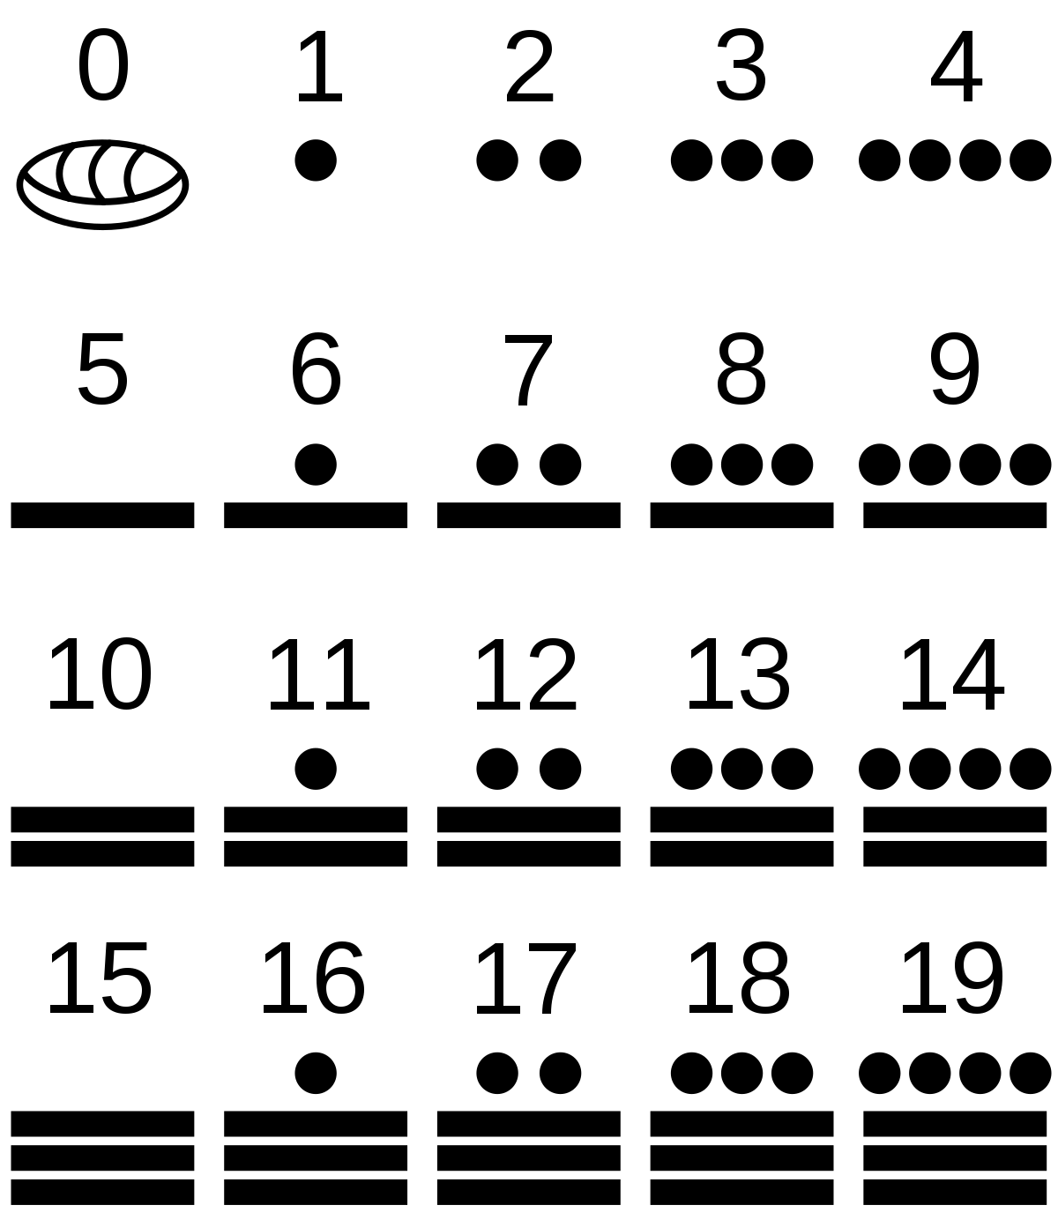
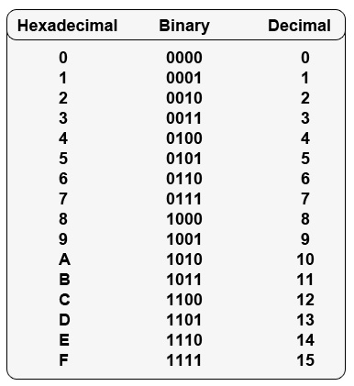
Not Just a Roman Numeral Calculator
Strong foundation to use Hail Caesar to implement other numeric systems or any calculator based applications

